Slide 1
Machine Learning
Unit - 3

Slide 2
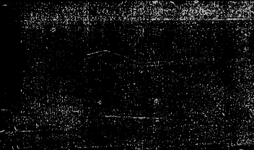
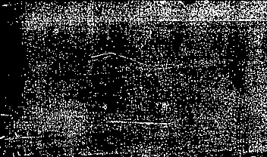
Topics to be Covered…
Linear Models: Least Squares method, Multivariate Linear Regression, Regularized Regression, Bias/Variance Trade-off, Dimension Reduction
Logistic Regression, Gradient Descent Perceptron, Support Vector Machines, Soft Margin SVM, Time Series Analysis, Forecasting

Slide 3
Least Squares Method
What Is the Least Squares Method?
The "least squares" method is a form of mathematical regression analysis used to determine the line of best fit for a set of data, providing a visual demonstration of the relationship between the data points. Each point of data represents the relationship between a known independent variable and an unknown dependent variable.
What Does the Least Squares Method Tell You?
The least squares method provides the overall rationale for the placement of the line of best fit among the data points being studied. The most common application of this method, which is sometimes referred to as "linear" or "ordinary", aims to create a straight line that minimizes the sum of the squares of the errors that are generated by the results of the associated equations, such as the squared residuals resulting from differences in the observed value, and the value anticipated, based on that model.
This method of regression analysis begins with a set of data points to be plotted on an x- and y-axis graph.

Slide 4
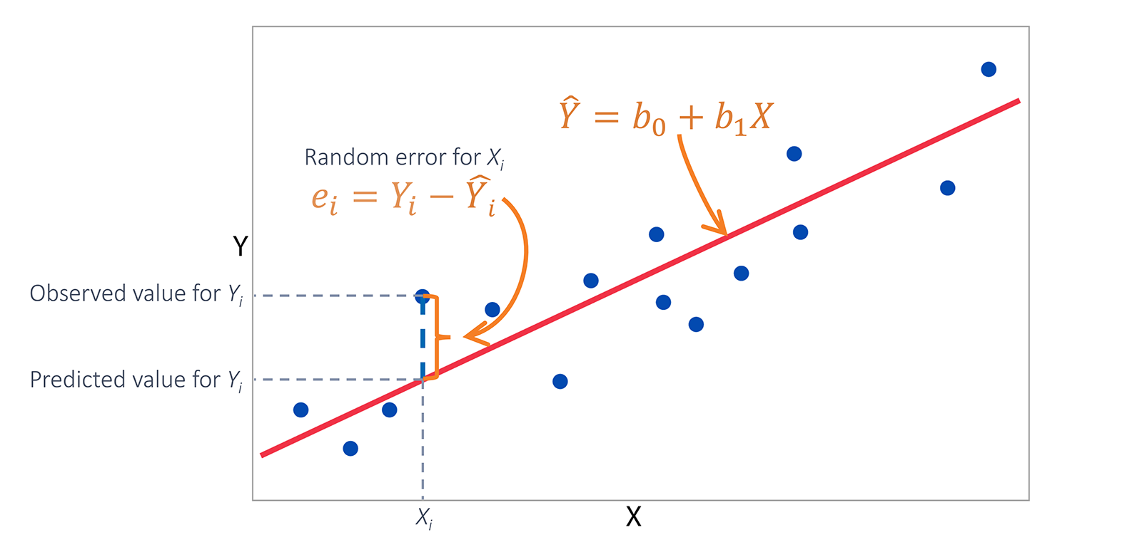

An analyst using the least squares method will generate a line of best fit that explains the potential relationship between independent and dependent variables.
In regression analysis, dependent variables are illustrated on the vertical y-axis, while independent variables are illustrated on the horizontal x-axis. These designations will form the equation for the line of best fit, which is determined from the least squares method.
When we fit a regression line to set of points, we assume that there is some unknown linear relationship between Y and X, and that for every one-unit increase in X, Y increases by some set amount on average.
Our fitted regression line enables us to predict the response, Y, for a given value of X.
But for any specific observation, the actual value of Y can deviate from the predicted value. The deviations between the actual and predicted values are called errors, or residuals.

Slide 5
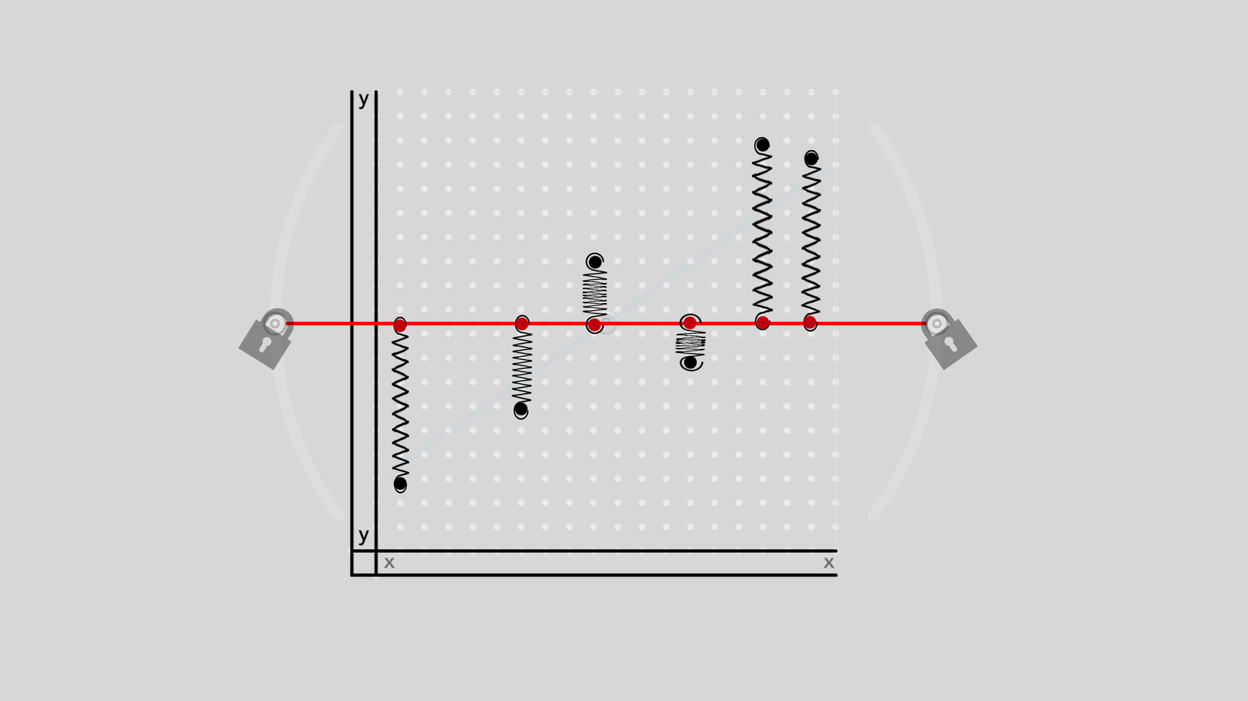
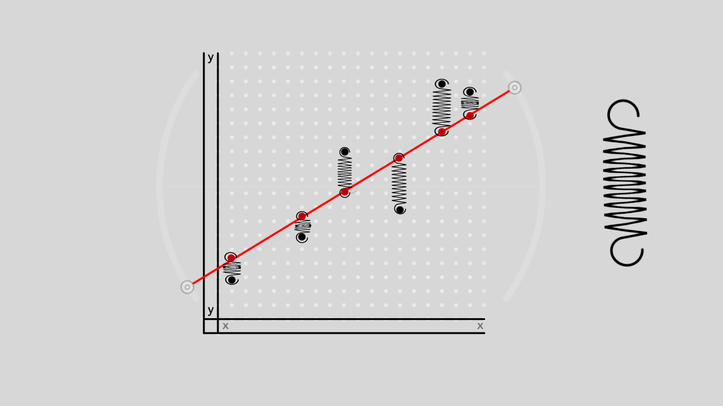
Visualizing the method of least squares
Let’s look at the method of least squares from another perspective. Imagine that you’ve plotted some data using a scatterplot, and that you fit a line for the mean of Y through the data. Let’s lock this line in place, and attach springs between the data points and the line.
Some of the data points are further from the mean line, so these springs are stretched more than others. The springs that are stretched the furthest exert the greatest force on the line.
What if we unlock this mean line, and let it rotate freely around the mean of Y? The forces on the springs balance, rotating the line. The line rotates until the overall force on the line is minimized.
The are some cool physics at play, involving the relationship between force and the energy needed to pull a spring a given distance. It turns out that minimizing the overall energy in the springs is equivalent to fitting a regression line using the method of least squares.

Slide 6
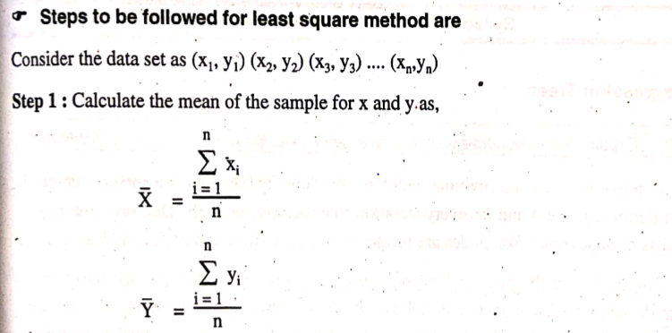

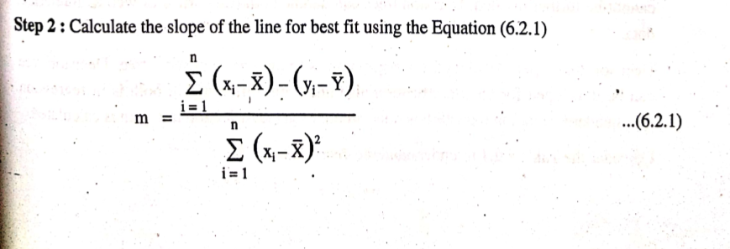

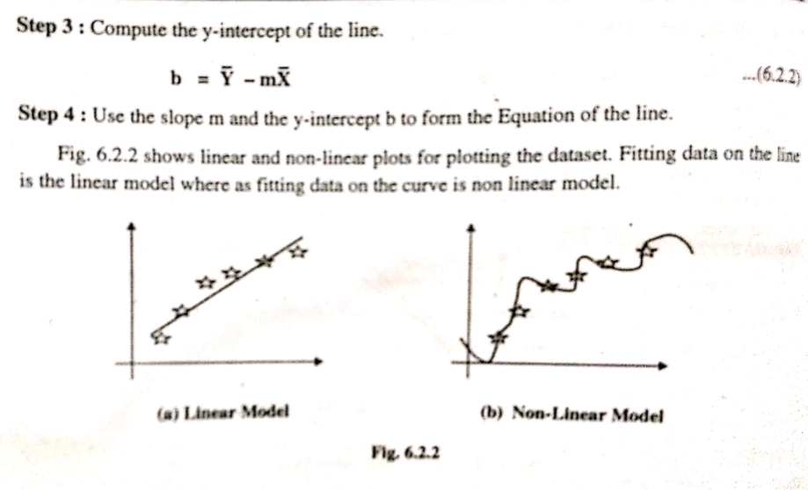

Slide 7
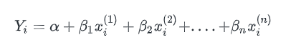
Multivariate Linear Regression
Multivariate Regression is one of the simplest Machine Learning Algorithm. It comes under the class of Supervised Learning Algorithms i.e, when we are provided with training dataset.
Multivariate Regression is a method used to measure the degree at which more than one independent variable (predictors) and more than one dependent variable (responses), are linearly related.
The method is broadly used to predict the behavior of the response variables associated to changes in the predictor variables, once a desired degree of relation has been established.
This is quite similar to the simple linear regression model we have discussed previously, but with multiple independent variables contributing to the dependent variable and hence multiple coefficients to determine and complex computation due to the added variables.
Jumping straight into the equation of multivariate linear regression,

Slide 8
Some of the problems that can be solved using this model are:
A researcher has collected data on three psychological variables, four academic variables (standardized test scores), and the type of educational program the student is in for 600 high school students. She is interested in how the set of psychological variables is related to the academic variables and the type of program the student is in.
A doctor has collected data on cholesterol, blood pressure, and weight. She also collected data on the eating habits of the subjects (e.g., how many ounces of red meat, fish, dairy products, and chocolate consumed per week). She wants to investigate the relationship between the three measures of health and eating habits.
A property dealer wants to set housing prices which are based various factors like Size of house, No of bedrooms, Age of house, etc.
Note:
Multiple Regression: The Multiple Regression model, relates more than one predictor and one response.
Multivariate Regression: The Multivariate Regression model, relates more than one predictor and more than one response.

Slide 9
Multivariate Linear Regression Example

Slide 10
Regularized Regression
Regularization is used as a solution to get rid out of the overfitting problem in multivariate regression, but it can be used in both univariate and multivariate regression.
In general, regularization means to make things regular or acceptable.
In the context of machine learning, regularization is the process which regularizes or shrinks the coefficients towards zero and in simple words, regularization discourages learning a more complex or flexible model, to prevent overfitting.
How Does Regularization Work?
The basic idea is to penalize the complex models i.e. adding a complexity term that would give a bigger loss for complex models. To understand it, let’s consider a simple relation for linear regression. Mathematically, it is stated as below:
Y≈ W_0+ W_1 X_1+ W_2 X_(2 )+⋯+W_P X_P
Where Y is the value to be predicted,
X_1,X_(2 ),〖…,X〗_P , are the features deciding the value of Y.
W_1,W_(2 ),〖…,W〗_P , are the weights attached to the features X_1,X_(2 ),〖…,X〗_P respectively.
W_0 represents the bias.

Slide 11
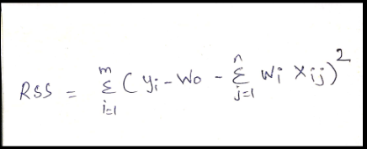
Regularization keeps all the features in Multivariate regression but reduces magnitude values of parameters θ_{j}
( θ mean weight of your function )
Cost Function : It is a measure that measures the performance of a ML model for a given data.
It qualifies error between predicted and expected values present in the form of single real number.
Depending upon the problem the cost function can be formed in many different ways.
Now, in order to fit a model that accurately predicts the value of Y, we require a loss function and optimized parameters i.e. bias and weights.
The loss function generally used for linear regression is called the residual sum of squares (RSS). According to the above stated linear regression relation, it can be given as:
/

Slide 12
Regularization Techniques
There are two main regularization techniques, namely Ridge Regression and Lasso Regression. They both differ in the way they assign a penalty to the coefficients.
They are also known as L1 (Lasso Regression) and L2 (Ridge Regression)
Ridge Regression (L2)
Ridge Regression is a technique which comes into picture when the data suffers from Multicollinearity (which simple means that independent variables are highly correlated).
In Multicollinearity concept, even though the least square estimates are unbiased, their variance are large which in turn return results in the deviation of the observed value far from the true values.
VALUE OBSERVED VALUE far from TRUE VALUE
Observed values – predicted value
True value – actual value

Slide 13
By adding a degree of bias to the regression estimates, ridge regression is able to reduce the standard error.
So Linear Regression:
Y = a + b * X
By adding an error term (degree of bias)
Y = a + b * X + e
(error term – it is the value needed to correct prediction error between the observed & predicted value)
Y = a+b₁X₁+b₂X₂+……+ e
In linear equation, it is possible to solve prediction error into sub components.
1st component – due to bias
2nd component – due to variance
Prediction error mostly occurs due to any one of these two or both component.

Slide 14
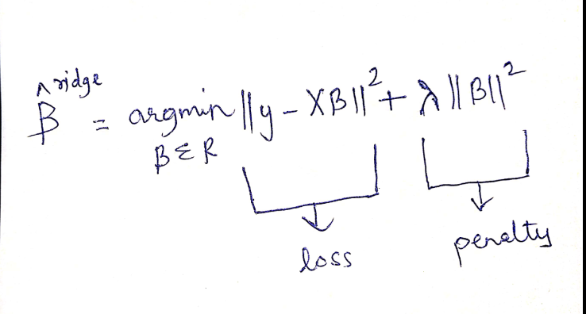
Ridge Regression solves the multicollinearity problem through shrinkage (lambda).
Here we have two components, First one is least square term & another is lambda of the summation of β² (beta square)
β is coefficient , is added to the least square term in order to shrink the parameter to have a very low variance
Important Terms:
It shrinks the value of coefficient but does not reach zero.
This regularization is called L2 Regularization.

Slide 15
Lasso Regression
It stands for least absolute shrinkage and selection operator.
Lasso Regression is a type of linear regression that uses shrinkage, where data values are shrunk towards a central point, like the mean.
The lasso procedure encourages simple, sparse models.
This is well suited for models showing high level of multicollinearity or when you want to automate certain parts of models selection, like variable selection or elimination.
Lasso was introduced in order to improve the prediction accuracy and interpretability of regression models.
This is done by taking only a subset of provided covariates for use in the final model rather than using all of them.
Lasso is an alternative to avoid many problems of overfitting in model.

Slide 16
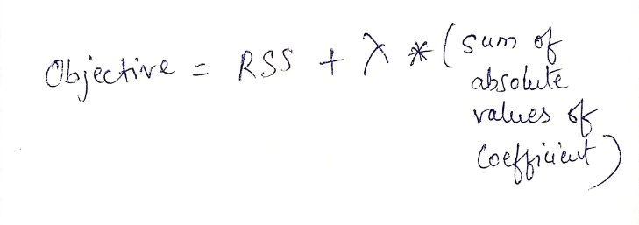
Lasso regression performs L1 regularization which adds a factor of sum of absolute values of coefficients in the optimization objective.
Where RSS stands for Least Squares Objective which is nothing but the linear regression objective without regularization and λ is the turning factor that controls the amount of regularization. The bias will increase with the increasing value of λ and the variance will decrease as the amount of shrinkage (λ) increases.
Here the turning factor λ controls the strength of penalty, that is
When λ = 0: We get same coefficients as simple linear regression
When λ = ∞: All coefficients are zero
When 0 < λ < ∞: We get coefficients between 0 and that of simple linear regression

Slide 17
Why Do You Need to Apply a Regularization Technique?
Often, the linear regression model comprising of a large number of features suffers from some of the following:
Overfitting: Overfitting results in the model failing to generalize on the unseen dataset.
Multicollinearity: Model suffering from multicollinearity effect.
Computationally Intensive: A model becomes computationally intensive.
When Do You Need to Apply Regularization Techniques?
Once the regression model is built and one of the following symptoms happen, you could apply one of the regularization techniques.
Model lack of generalization: Model found with higher accuracy fails to generalize on unseen or new data.
Model instability: Different regression models can be created with different accuracies. It becomes difficult to select one of them.

Slide 18
Bias/Variance Trade-off
Bias & variance are ways of measuring the difference between your prediction and actual outcome.
Bias is called as error. It is useful to quantify how much on an average are the predicted values different from the actual values.
(gap between your predicted value and the actual value or outcome)
Variance helps to quantify how are the prediction made on some observation different from each other.
(when your predicted values are scattered all over the places)
A high bias error in a model results to have a under performing model, which keeps on missing important trends.
A high variance model will overfit on your training population and perform badly on any observation beyond training

Slide 19
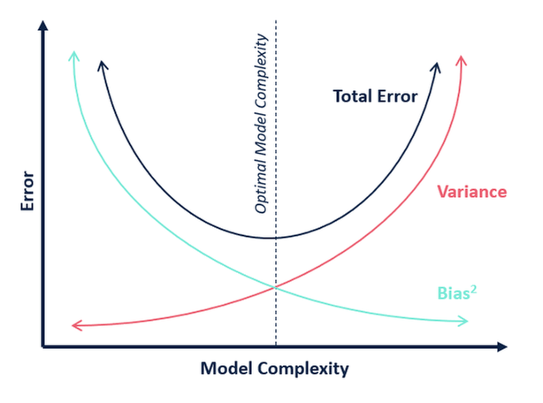
Bias VS Variance Tradeoff
High Bias / High Variance - Consistently wrong is an inconsistent way.
High Bias / Low Variance - Consistently wrong.
Low Bias / High Variance - One bulls target.
High Bias can led to missing of the relevance data or feature needed for the target value in other words leads to underfitting.
High Variance can lead to generation of random noise in the training data and can deviate the output that leads to overfitting.
In order to have perfect fit in the model, the bias & variance should be balanced.

Slide 20
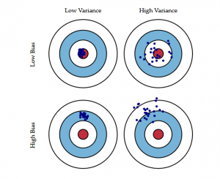
The following bulls-eye diagram explains the tradeoff better:
The center i.e. the bull’s eye is the model result we want to achieve that perfectly predicts all the values correctly.
As we move away from the bull’s eye, our model starts to make more and more wrong predictions.
A model with low bias and high variance predicts points that are around the center generally, but pretty far away from each other.
A model with high bias and low variance is pretty far away from the bull’s eye, but since the variance is low, the predicted points are closer to each other.
we learned that an ideal model would be one where both the bias error and the variance error are low. However, we should always aim for a model where the model score for the training data is as close as possible to the model score for the testing data.
That’s where we figured out how to choose a model that is not too complex (High variance and low bias) which would lead to overfitting and nor too simple(High Bias and low variance) which would lead to underfitting.
Bias and Variance plays an important role in deciding which predictive model to use.

Slide 21
Dimension Reduction
In ML during classification , we get many cases when we cross “N” no of dimensions or features/ parameters/ attributes
The motivation behind dimensionality reduction is to cut down (remove/ eliminate) unwanted dimensions or features which will finally classify the dataset into correct class.
Dimensionality reduction can also be referred as the process of converting a set of data having base dimensions into data with lesser dimension ensuring that it provides the same or similar information.
Let’s understand with example, if we have say 2 dimensions X1 and X2.
Which tells us the measurements of several objects in cm(X1) & inches(X2).
Now if we use both these dimensions in machine learning, they will convey similar information & introduce a lot of noise in system. So better to use one dimension in place of two.
We then convert the dimension of data 2D (from X1 & X2) to 1D(Z1).

Slide 22
Process of Dimensionality reduction can be divided into mainly 2 types.
Feature Selection & Feature Extraction.
Methods: Dimensionality reduction techniques
Missing Value Ratio: dataset has Attributes/Columns has many missing values which is not useful feature.
Low Variance: We compare feature to feature and see the value and difference. The value and difference that are minimum or has minimum difference is been removed.
High Correlation Filter: Here if a one feature is contributing an information and at the same time another feature is contributing the same information then we see high correlation between both the feature, since the information derived by both the features are same we tend to remove one feature amongst both.
PCA: Also known as principal component analysis, also they are orthogonal in nature. It is like a tool that can be used to reduce a large set of variables to a small set that still contains most of the information that the large set had. Mathematical procedures that transforms a number of possible or correlated variables into a smaller number of uncorrelated variable called as PCA.
Back feature elimination: here we have number of feature , say (n) feature so once we train the model by using back feature elimination method we tend to train it as (n) train, (n-1) train, (n-2) train. We train all the feature and check the error rate for each feature. If the error rate is less we keep the feature for model building going ahead, but if the error rate is increasing then we remove the feature.
Forward feature elimination: here we first create a empty list of feature, and then add feature that has list that has less error using the mechanism (n) train, (n+1)train, (n+2) train and so on.

Slide 23
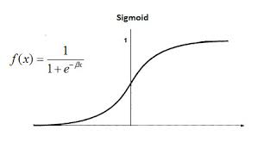
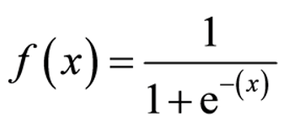
Logistic Regression
Logistic Regression is used for a different class of problems known as classification problem.
Here the aim is to predict the group which any current object under observation belongs to.
It gives you a discrete binary outcome between 0 & 1.
A simple example would be whether a person will vote or not in a upcoming elections.
How does it works?
Logistic regression measures the relationship between the dependent variable (our label, what we want to predict) and the one or more independent variables (our features), by estimating probabilities using its underlying logistic function.
It uses sigmoid function which is given as

Slide 24
The sigmoid function is an S- Shaped Curve that can take any real valued number and map it into a value between the range of 0 to 1, but never exactly at those limits.
Making Predictions:
These probabilities must then be transformed into binary values in order to actually make a prediction.
This is the task of the logistic function also called a sigmoid function.
This values between 0 & 1 will then be transformed into either 0 or 1 using a threshold classifier.
Logistic Vs Linear:
Logistic regression gives you a discrete outcome but Linear regression gives you a continuous outcome

Slide 25
Example

Slide 26
Time Series Analysis & Forecasting
Time Series Analysis also known as TSA.
TSA consist of method used to analyse various data facts or statistics from various characteristics of the data.
TSA used for continuous data, for example economic growth of an organization, share price, sales temperature, weather etc.
TSA model has time ‘t’ as an independent variable & the target is a dependent variable denoted by Yt
The output from the time series model is a a predicted value of y at the given time t.
Time Series is the process of recording of the data at regular interval of time.
TSA Components:
TRENDS , CYCLES, SEASONALITY

Slide 27
Trends:
Considered to behaviour of the feature at a particular amount of time, it can be categorized as increasing trend, decreasing trend or constant trend.
Seasonality:
Pattern which repeats at the constant frequency. Example here the demand for the umbrella will be at peak in the rainy season.
Cycles:
They are the type of seasonality pattern but it doesn’t repeat at regular frequency.
Cycles can be generally considered as the task completion time.
Example: Iterative model of S/W Engineering, every iteration can have different time requirement. But here every task has to undergo all stage in a single iteration.
Most widely used time series analysis is Autoregressive Moving Average (ARMA),
Which has two parts in them (AR) Autoregressive and (MA) Moving Average.

Slide 28
Forecasting:
The Process of making prediction of future based on the present and the past data most commonly by using analysis of trends is called as forecasting.
Steps for forecasting:
Define the goal or business object.
Get the required data.
Explores & Visualize the series.
Pre- process the data.
Partition the series.
Apply suitable forecasting model(ARMA Model)
Evaluate & compare the performance of the system.
Implement the final forecasting system.

Slide 29
Perceptron
What is a neural network?
A neural network is formed when a collection of nodes or neurons are interlinked through synaptic connections.
There are three layers in every artificial neural network – input layer, hidden layer, and output layer.
The input layer that is formed from a collection of several nodes or neurons receives inputs.
Every neuron in the network has a function, and every connection has a weight value associated with it.
Inputs then move from the input layer to layer made from a separate set of neurons – the hidden layer. The output layer gives the final outputs.

Slide 30
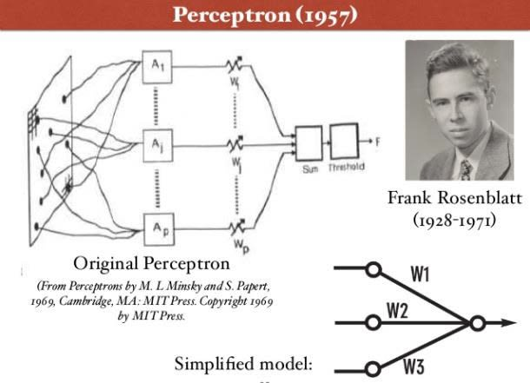
Perceptron
A perceptron is a neural network unit (an artificial neuron) that does certain computations to detect features or business intelligence in the input data.
A perceptron, a neuron’s computational prototype, is categorized as the simplest form of a neural network.
Frank Rosenblatt invented the perceptron at the Cornell Aeronautical Laboratory in 1957.
A perceptron has one or more than one inputs, a process, and only one output.
The concept of perceptron has a critical role in machine learning.
It is used as an algorithm or a linear classifier to facilitate supervised learning of binary classifiers.
Supervised learning is amongst the most researched of learning problems.
A supervised learning sample always consists of an input and a correct/explicit output.
The objective of this learning problem is to use data with correct labels for making predictions on future data, for training a model.
Some of the common problems of supervised learning include classification to predict class labels.

Slide 31
A linear classifier that the perceptron is categorized as is a classification algorithm, which relies on a linear predictor function to make predictions.
Its predictions are based on a combination that includes weights and feature vector.
The linear classifier suggests two categories for the classification of training data.
This means, if classification is done for two categories, then the entire training data will fall under these two categories.
The perceptron algorithm, in its most basic form, finds its use in the binary classification of data.
Perceptron takes its name from the basic unit of a neuron, which also goes by the same name.

Slide 32
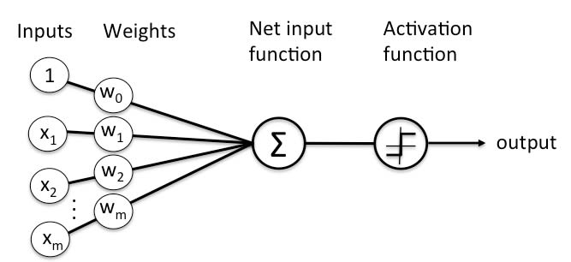
There are two types of Perceptrons: Single layer and Multilayer.
Single layer Perceptrons can learn only linearly separable patterns.
Multilayer Perceptrons or feedforward neural networks with two or more layers have the greater processing power.
The Perceptron algorithm learns the weights for the input signals in order to draw a linear decision boundary.
This enables you to distinguish between the two linearly separable classes +1 and -1.

Slide 33
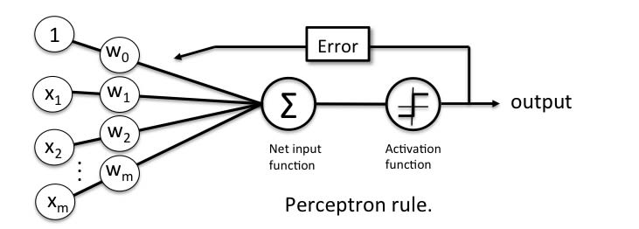
Perceptron Learning Rule
Perceptron Learning Rule states that the algorithm would automatically learn the optimal weight coefficients.
The input features are then multiplied with these weights to determine if a neuron fires or not.
The Perceptron receives multiple input signals, and if the sum of the input signals exceeds a certain threshold, it either outputs a signal or does not return an output.
In the context of supervised learning and classification, this can then be used to predict the class of a sample.

Slide 34
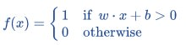
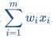
Perceptron Function
Perceptron is a function that maps its input “x,” which is multiplied with the learned weight coefficient; an output value ”f(x)”is generated.
In the equation given above:
“w” = vector of real-valued weights
“b” = bias (an element that adjusts the boundary away from origin without any dependence on the input value)
“x” = vector of input x values
“m” = number of inputs to the Perceptron
The output can be represented as “1” or “0”. It can also be represented as “1” or “-1” depending on which activation function is used.

Slide 35

Inputs of a Perceptron
A Perceptron accepts inputs, moderates them with certain weight values, then applies the transformation function to output the final result.
The above below shows a Perceptron with a Boolean output.
A Boolean output is based on inputs such as salaried, married, age, past credit profile, etc. It has only two values: Yes and No or True and False.
The summation function “∑” multiplies all inputs of “x” by weights “w” and then adds them up as follows:

Slide 36
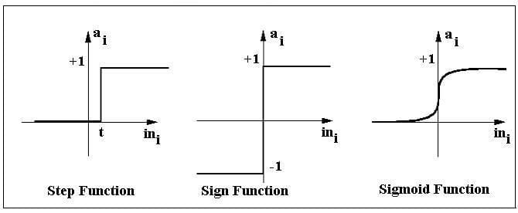
Activation Functions of Perceptron
The activation function applies a step rule (convert the numerical output into +1 or -1) to check if the output of the weighting function is greater than zero or not.
Step function gets triggered above a certain value of the neuron output; else it outputs zero.
Sign Function outputs +1 or -1 depending on whether neuron output is greater than zero or not.
Sigmoid is the S-curve and outputs a value between 0 and 1.

Slide 37
Steps to perform a perceptron learning algorithm
Feed the features of the model that is required to be trained as input in the first layer.
All weights and inputs will be multiplied – the multiplied result of each weight and input will be added up
The Bias value will be added to shift the output function
This value will be presented to the activation function (the type of activation function will depend on the need)
The value received after the last step is the output value.

Slide 38
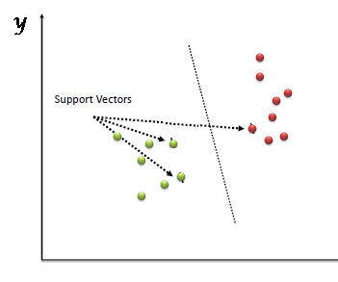
Support Vector Machine(SVM)
Support Vector Machine” (SVM) is a supervised machine learning algorithm which can be used for both classification or regression challenges.
However, it is mostly used in classification problems.
In the SVM algorithm, we plot each data item as a point in n-dimensional space (where n is number of features you have) with the value of each feature being the value of a particular coordinate.
Then, we perform classification by finding the hyper-plane that differentiates the two classes very well.
Support Vectors are simply the co-ordinates of individual observation.
The SVM classifier is a frontier which best segregates the two classes (hyper-plane/ line).

Slide 39
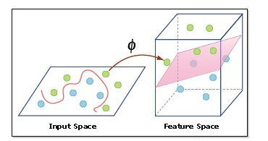
Hyperparameters of the Support Vector Machine (SVM) Algorithm
There are a few important parameters of SVM that you should be aware of before proceeding further:
Kernel: A kernel helps us find a hyperplane in the higher dimensional space without increasing the computational cost. Usually, the computational cost will increase if the dimension of the data increases. This increase in dimension is required when we are unable to find a separating hyperplane in a given dimension and are required to move in a higher dimension(mentioned in the picture).
Hyperplane: This is basically a separating line between two data classes in SVM. But in Support Vector Regression, this is the line that will be used to predict the continuous output
Decision Boundary: A decision boundary can be thought of as a demarcation line (for simplification) on one side of which lie positive examples and on the other side lie the negative examples. On this very line, the examples may be classified as either positive or negative. This same concept of SVM will be applied in Support Vector Regression as well

Slide 40
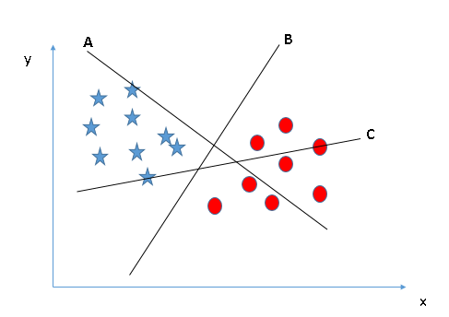
How does it work?
Identify the right hyper-plane (Scenario-1): Here, we have three hyper-planes (A, B and C). Now, identify the right hyper-plane to classify star and circle. You need to remember a thumb rule to identify the right hyper-plane: “Select the hyper-plane which segregates the two classes better”. In this scenario, hyper-plane “B” has excellently performed this job.

Slide 41
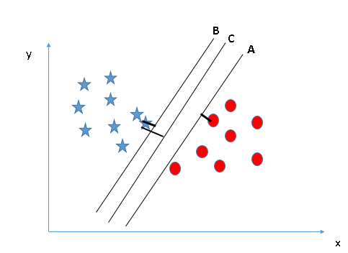
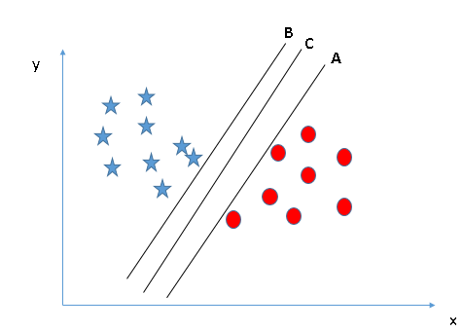
Identify the right hyper-plane (Scenario-2): Here, we have three hyper-planes (A, B and C) and all are segregating the classes well. Now, How can we identify the right hyper-plane?
Here, maximizing the distances between nearest data point (either class) and hyper-plane will help us to decide the right hyper-plane. This distance is called as Margin.
Above, you can see that the margin for hyper-plane C is high as compared to both A and B. Hence, we name the right hyper-plane as C. Another lightning reason for selecting the hyper-plane with higher margin is robustness. If we select a hyper-plane having low margin then there is high chance of miss-classification.

Slide 42
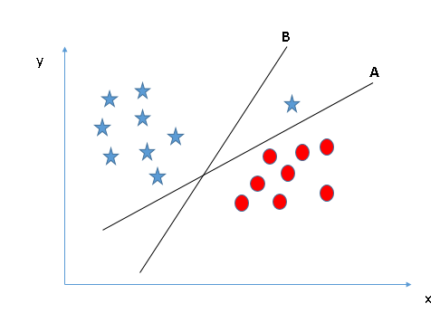
Identify the right hyper-plane (Scenario-3):Hint: Use the rules as discussed in previous section to identify the right hyper-plane
Some of you may have selected the hyper-plane B as it has higher margin compared to A. But, here is the catch, SVM selects the hyper-plane which classifies the classes accurately prior to maximizing margin. Here, hyper-plane B has a classification error and A has classified all correctly. Therefore, the right hyper-plane is A.

Slide 43
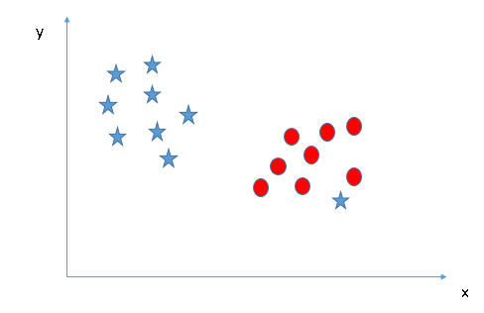
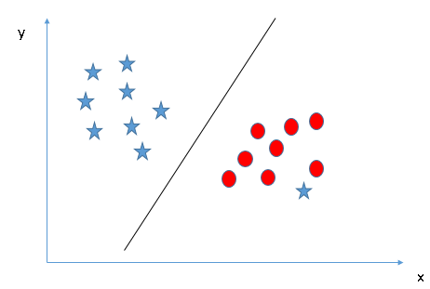
Can we classify two classes
(Scenario-4)?:
Below, I am unable to segregate the two classes using a straight line, as one of the stars lies in the territory of other(circle) class as an outlier.
As I have already mentioned, one star at other end is like an outlier for star class. The SVM algorithm has a feature to ignore outliers and find the hyper-plane that has the maximum margin. Hence, we can say, SVM classification is robust to outliers.

Slide 44
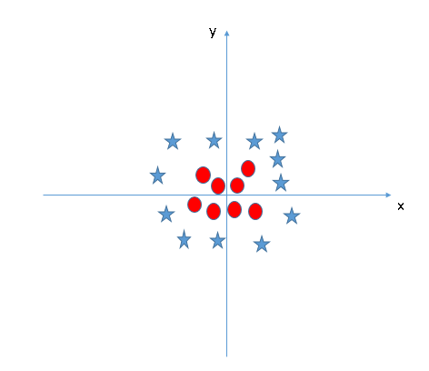
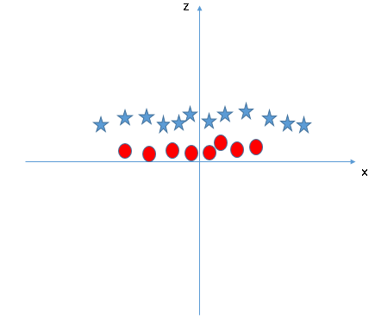
Find the hyper-plane to segregate to classes (Scenario-5):
In the scenario below, we can’t have linear hyper-plane between the two classes, so how does SVM classify these two classes? Till now, we have only looked at the linear hyper-plane.
SVM can solve this problem. Easily! It solves this problem by introducing additional feature. Here, we will add a new feature z=x^2+y^2. Now, let’s plot the data points on axis x and z.
In the final plot, points to consider are:
All values for z would be positive always because z is the squared sum of both x and y
In the original plot, red circles appear close to the origin of x and y axes, leading to lower value of z and star relatively away from the origin result to higher value of z.

Slide 45
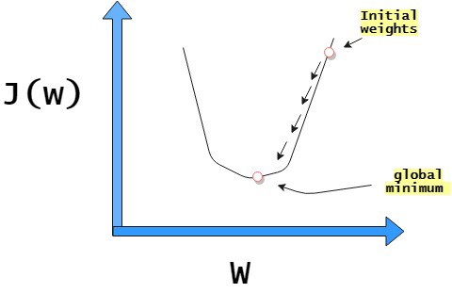
Gradient Descent
What is Gradient Descent?
It is an optimization algorithm used to find the values of parameters .i.e. coefficients of a function (f) that minimizes a cost function (cost).
It is defined as First-order iterative optimization algorithm for finding the minimum of a loss function.
It is also one of the most popular and widely used optimization algorithm.
Given a machine learning model with parameters (weights and biases) and a cost function to see how good a model is, our learning problem reduces to find a good set of weights for our model which minimizes the cost function.
(Cost Function : It is a measure that measures the performance of a ML model for a given data.)
(Learning Problem: It is a decision problem that needs to be modelled from data)

Slide 46
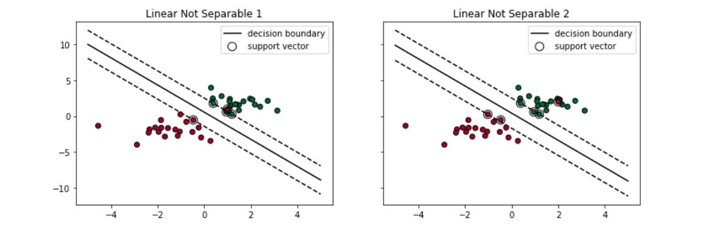
Soft Margin SVM
What Soft Margin does is:
The soft margin SVM gives more flexibility by allowing some of the training points to be misclassified.
It tolerates a few dots to get misclassified
It tries to balance the trade-off between finding a line that maximizes the margin and minimizes the misclassification.
Two types of misclassifications can happen:
1. The dot is on the wrong side of the decision boundary but on the correct side/ on the margin (shown in left)
2. The dot is on the wrong side of the decision boundary and on the wrong side of the margin (shown in right)
Either case, the support vector machine tolerates those dots to be misclassified when it tries to find the linear decision boundary.

Slide 47
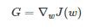
Gradient descent is an iterative method.
So we start some value for our model parameters (weights and biases), and improve them slowly.
To improve a set of weights, we try to get a sense in terms of the value of the cost function for weights similar to the current weights (by calculating the gradient) and move in the direction in which the cost function reduces (decreases or is negative).
So standing on an iterative methodology we tend to repeat this step thousands of times.
Hence by this we’ll minimize our cost function by the above explained iterative process.
Let’s try to know the Equations and formulas in it:
Gradient descent is used to minimize a cost function J(w) which is parameterized alongside by a model parameters w. The gradient (or derivative) shows us the incline or slope of the cost function. So to minimize the cost function, we move in the direction opposite to the gradient.
Let G be the gradient of the cost function with respect to the parameters at a particular value w of the weight vector. That is,

Slide 48
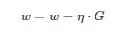
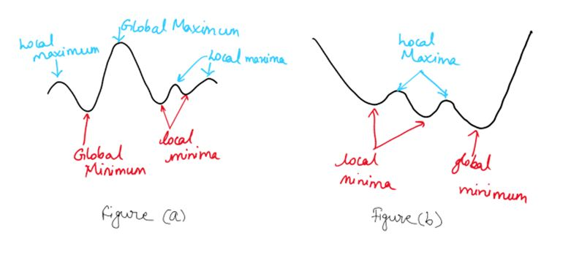
Thereafter, the gradient descent step is given by
η = learning rate that determines the size of the steps which is taken to reach a minimum
Note : Here we just need to be careful about this parameter i.e. high values of η may go past the global minimum & then the low value will reach minimum slowly.

Slide 49
Steps to perform Gradient Descent:
Step 1. Initialize the weights w randomly
Step 2. Calculate the gradients G of cost function w.r.t parameters
Step 3. Update the weights by an amount proportional to G, i.e. w = w -ηG
Step 4. Repeat until J(w) stops reducing or other pre-defined termination criteria is met

Slide 50
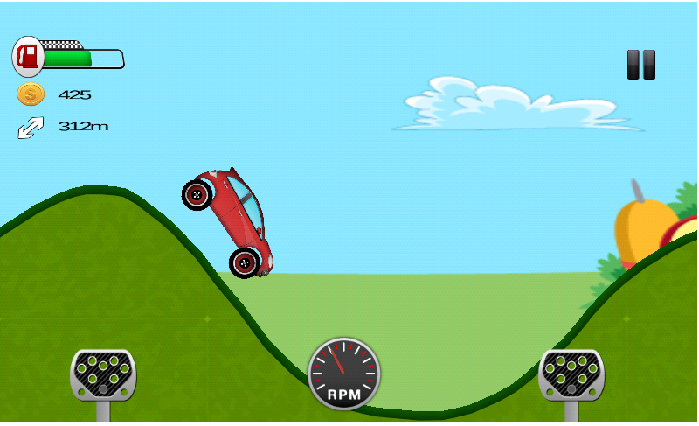
Let’s think little & understand more with below example
Imagine you’re blind folded riding the car, and your objective is to reach the lowest altitude.
One of the simplest strategies you can use, is to the tyre wheel on the ground will move only in the downward direction on the slope downwards, and considering that it is taking a step in the direction where the ground is descending the fastest (the tyre wheel moves fast on that direction).
If you keep repeating this process, you might slide up & down, and land up somewhere in the minimum side of the valley.
The riding car is analogous to the cost function.
Minimizing the cost function is analogous on trying to reach the lower altitudes.
Feeling the slope by the cars wheel around is analogous to calculating the gradient, and taking a step and moving the car on slope is analogous to one iteration for the parameter.

Slide 51
Finally let’s see the multiple variants of Gradient Descent
It consists of multiple variants which are used depending on the amount of data which is being used to calculate the gradient.
Reason for this variation is the computational efficiency of the models because they can have many (million) data points in a datasets.
So in this calculating entire dataset is very expensive. So it is divided as the
Batch gradient descent, Stochastic gradient descent & Mini-Batch Gradient descent.
Batch gradient descent
It computes the gradient of the cost function w.r.t to parameter w for entire training data.
As we need to calculate the gradients for the entire dataset to perform one basic parameter update.
Hence batch gradient descent can be very slow as of it computational efficiency.

Slide 52
Stochastic gradient descent
Here it computes the gradient for each training sample (xi) i.e. a single training data point is used for each update.
Mini-Batch gradient descent
Here we calculate the gradient for each small mini-batch of training data.
We perform it as:
First divide the training data into small batches (say M samples / batch) then we perform one update per mini-batch. M is usually in the range 30–500, depending on the problem.
Amongst all of these mini-batch & Stochastic Gradient Descent are most popular.
Here mini-batch is used for computing infrastructure which can be compliers or CPUs

